Slide 1
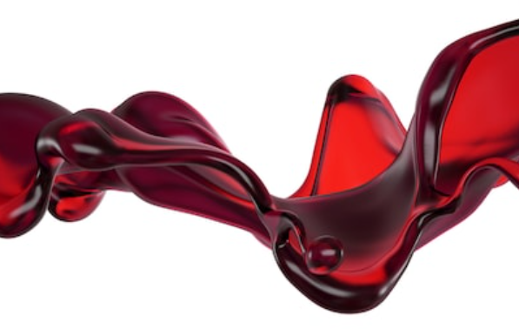
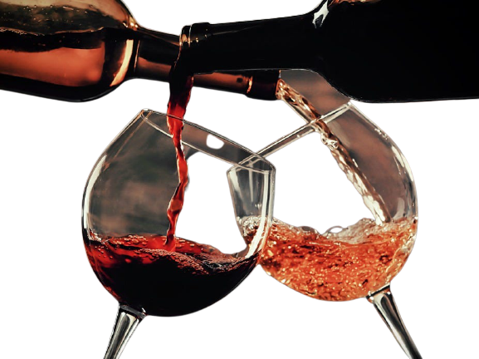
RED WINE QUALITY Prediction with Machine Learning

Slide 2
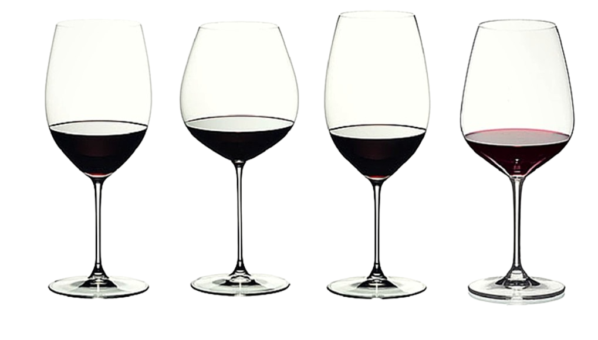
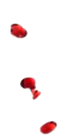
Venkat
John
Jonelle
Eric
Cabernet
Pinot Noir
Shiraz
Bordeaux
Venkat

Slide 3
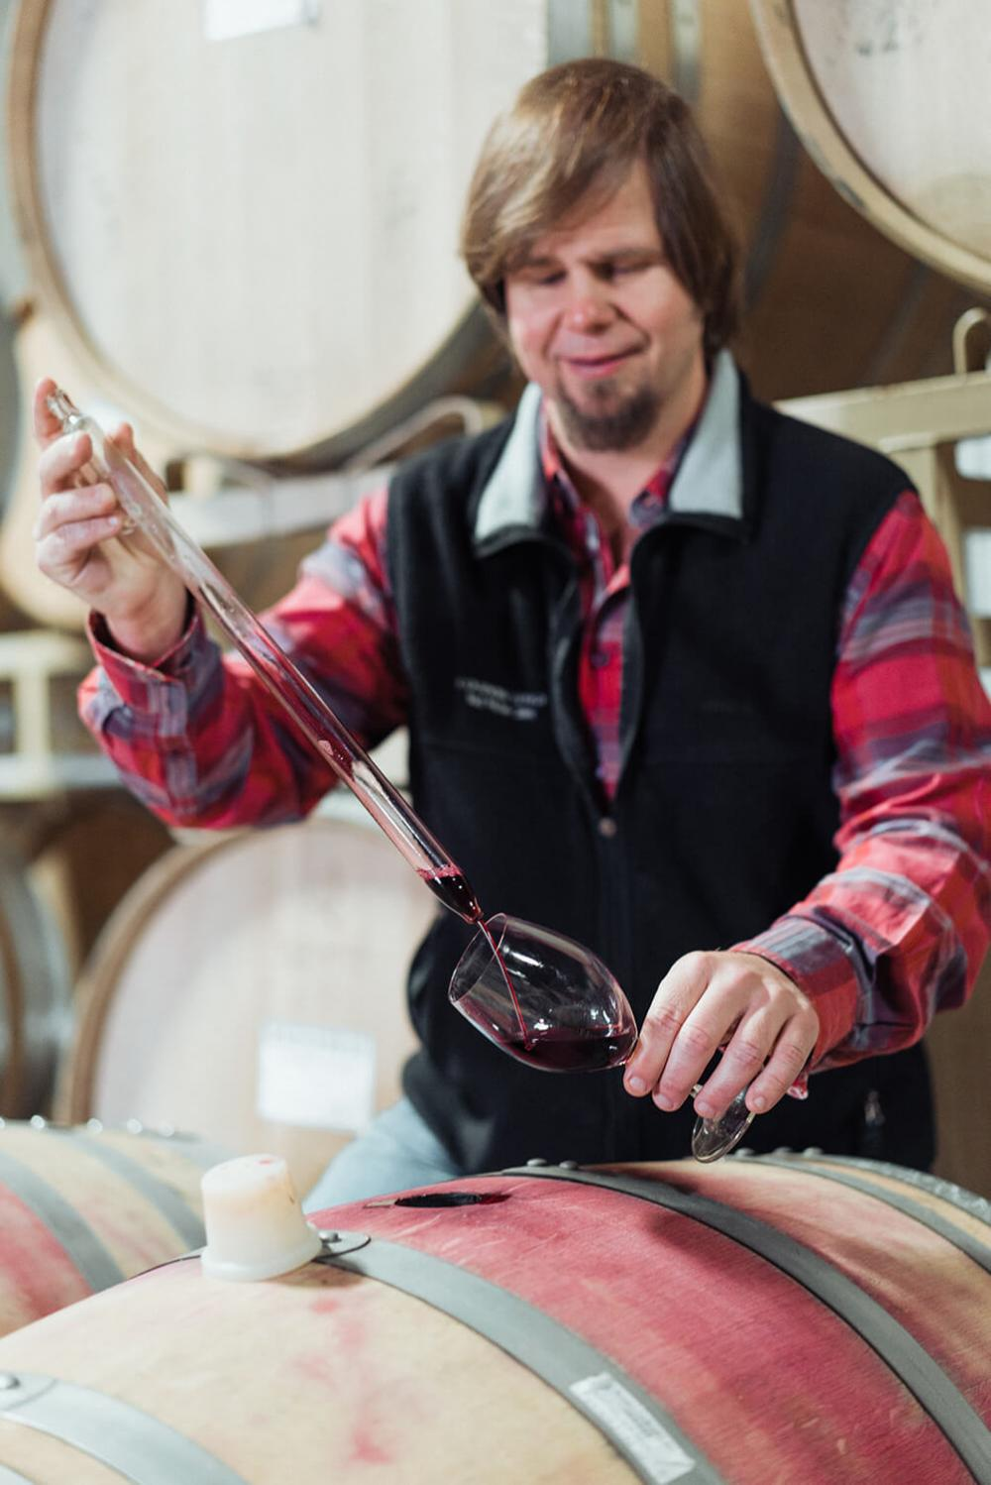
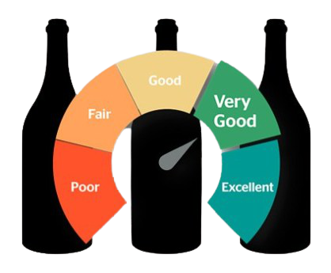
Introduction
Different qualities of wine exist in the market. The quality of the wine affects directly the price of the wine.
As a winemaker, we are constantly finding ways to improve the quality of the wine.
Venkat

Slide 4
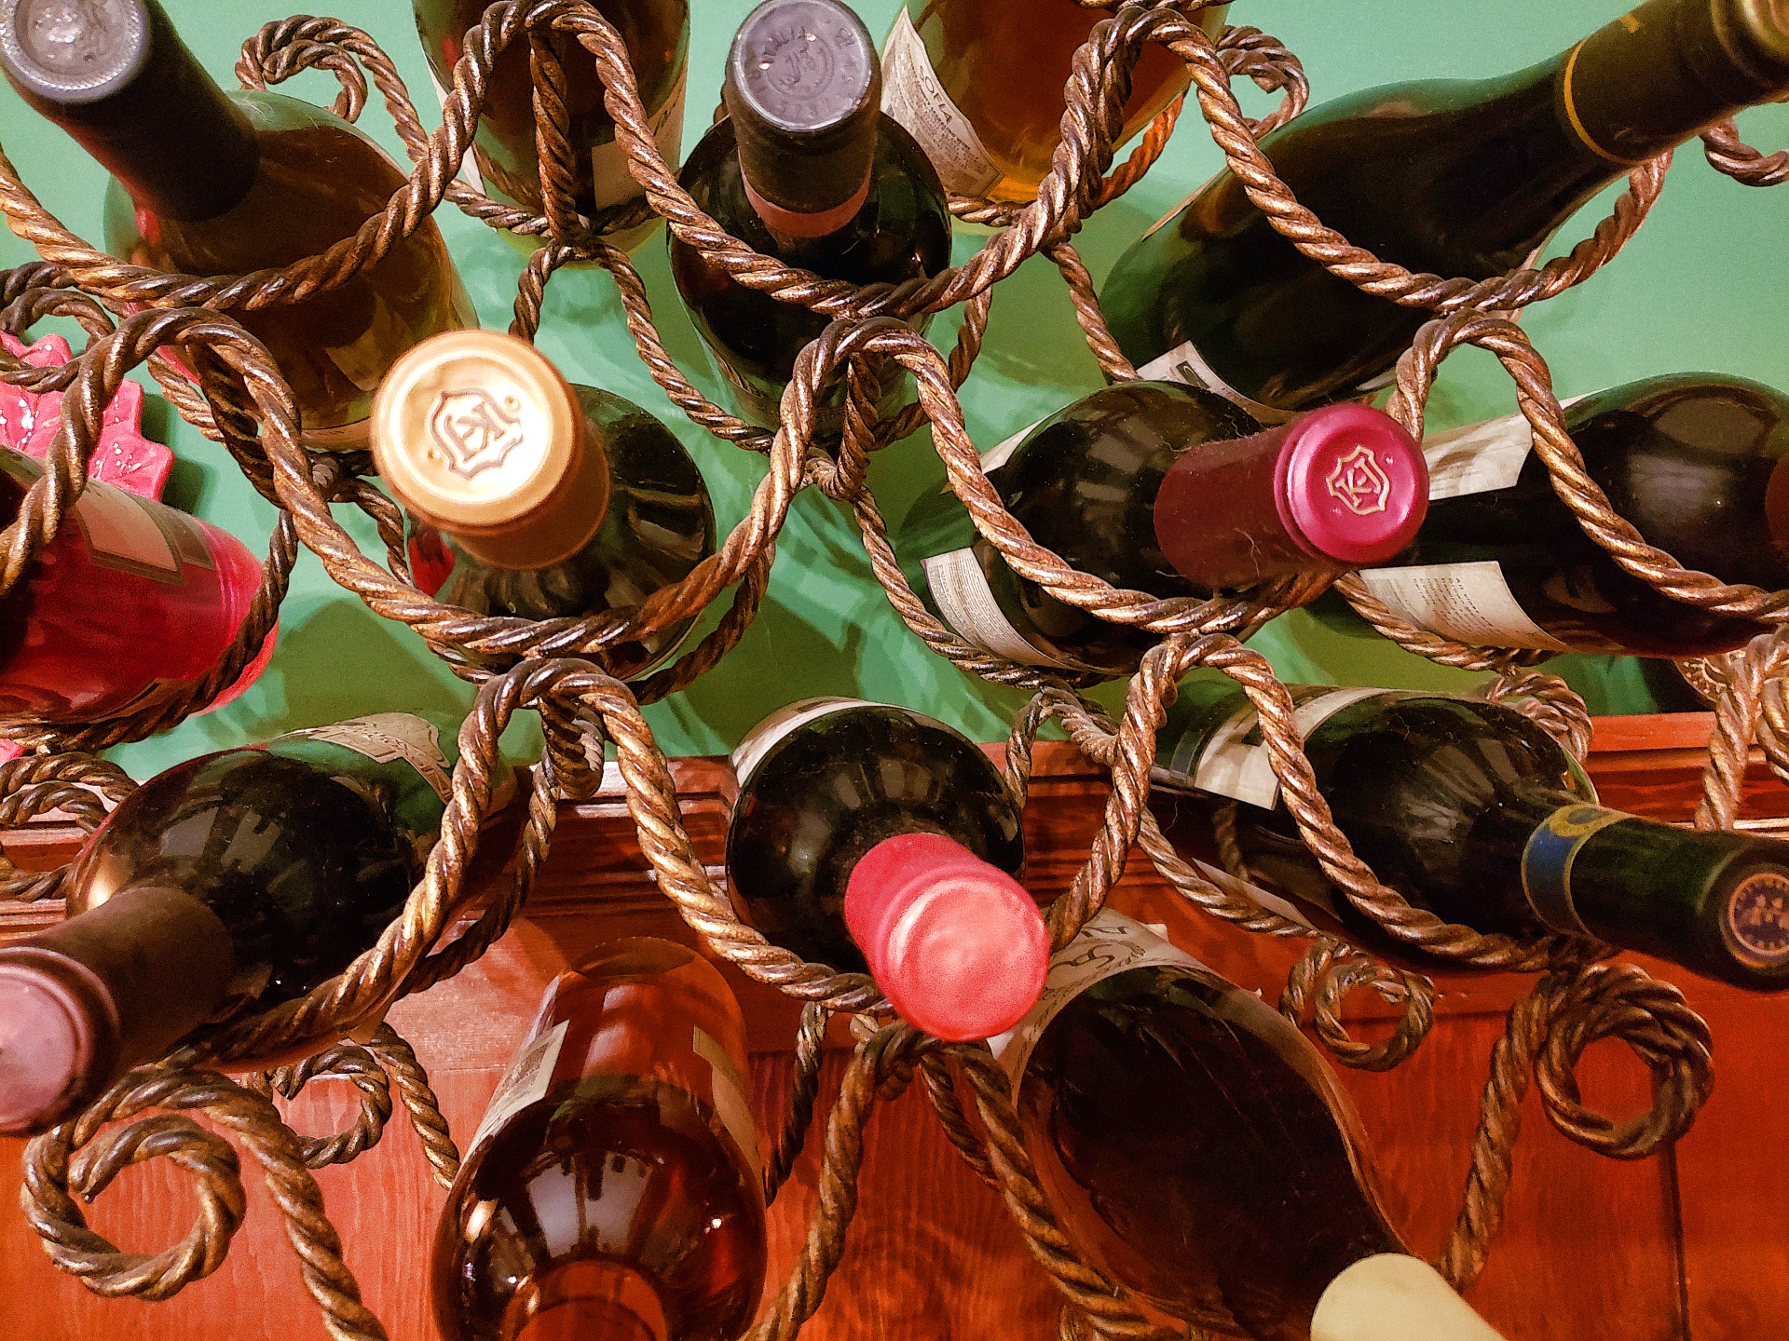

Business Challenge
To predict a red wine’s eventual quality rating, given only the laboratory test results as inputs. We will also help to determine which features of the wine are most important when it comes to affecting the wine’s quality.
Venkat

Slide 5
Table of Contents
Planning Analytics
Design Thinking Methodology
Business Understanding
HMW Statement
Empathy Map
Persona
As-Is Scenario Map
Reframed HMW Statement
Pain Points
Hill
Descriptive Analytics
Data Exploration & Preparation
Data Understanding
Data Attributes
Data Representation & Transformation
Statistical Analysis
Diagnostic Analytics
Data Visualization & Presentation
Histogram
Box Plot
Correlation Heatmap
Predictive Analytics
Platform Selection
Auto AI – Algorithm
Model Evaluation
Feature Importance
Prescriptive Analytics
Model Deployment
Model Testing
Model Management
Conclusion
Venkat

Slide 6
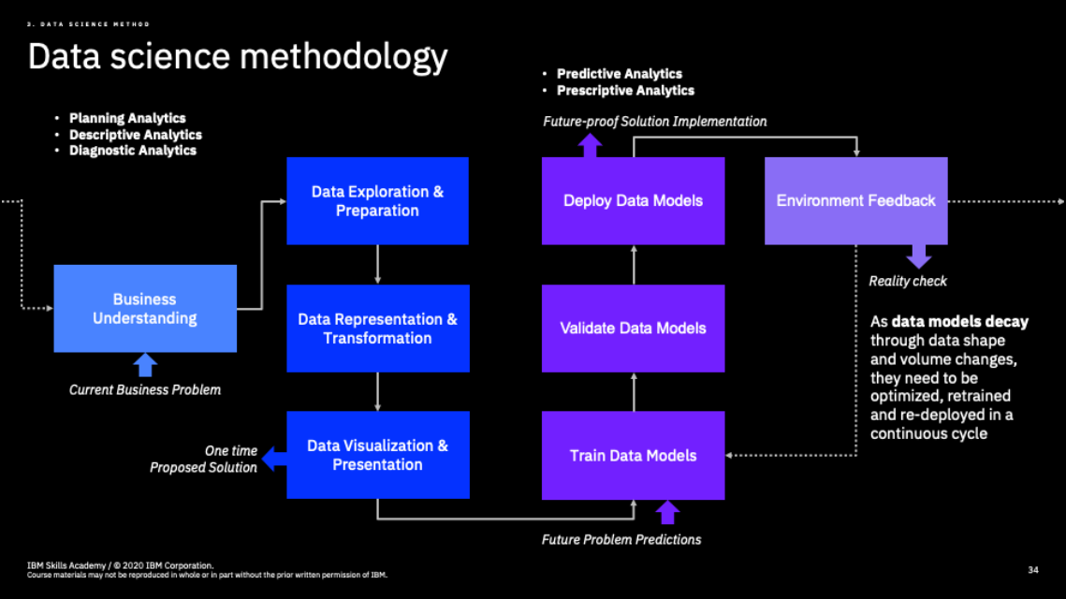
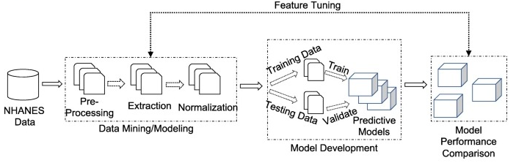
Venkat

Slide 7
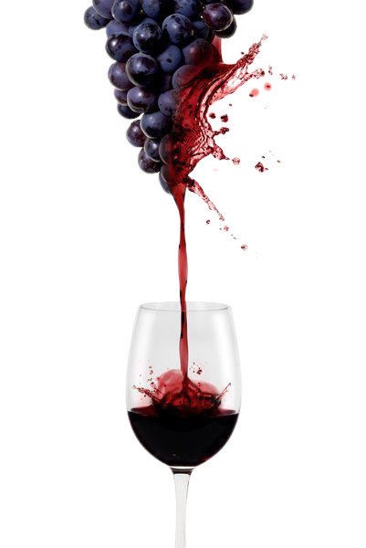

Data Science Methodology 5 stages in Data Science
Planning Analytics
Descriptive Analytics
Diagnostic Analytics
Predictive Analytics
Prescriptive Analytics
Venkat

Slide 8
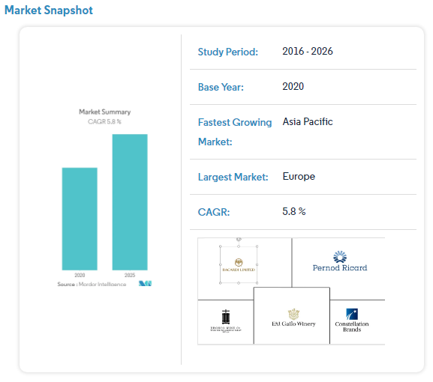
Business Understanding
The global wine market is forecasted to grow with a CAGR(Compound Annual Growth Rate) of 5.8% in the next 5 years.
Nowadays, wine industry players are using wine certification and quality assessment to promote their products. Nevertheless, this is a time consuming and expensive process, as it requires assessment given by human experts.
Furthermore, the price of wine depends on an abstract concept of wine appreciation by wine tasters, opinion among whom may have a high degree of variability.
An important factor in wine certification and and quality assessment is physicochemical tests, which are laboratory-based and consider factors like acidity, pH level, sugar, and other chemical properties.
The wine market would be of interest if the human quality of tasting can be related to wine’s chemical properties so that certification and quality assessment and assurance processes are more controlled.
This project aims to determine which features are the best quality red wine indicators and generate insights into each of these factors to our model’s red wine quality.
Venkat

Slide 9
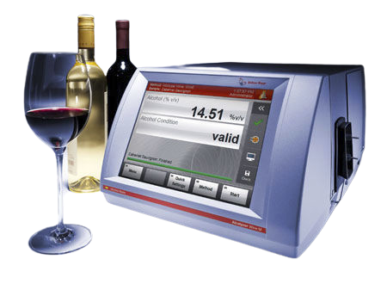
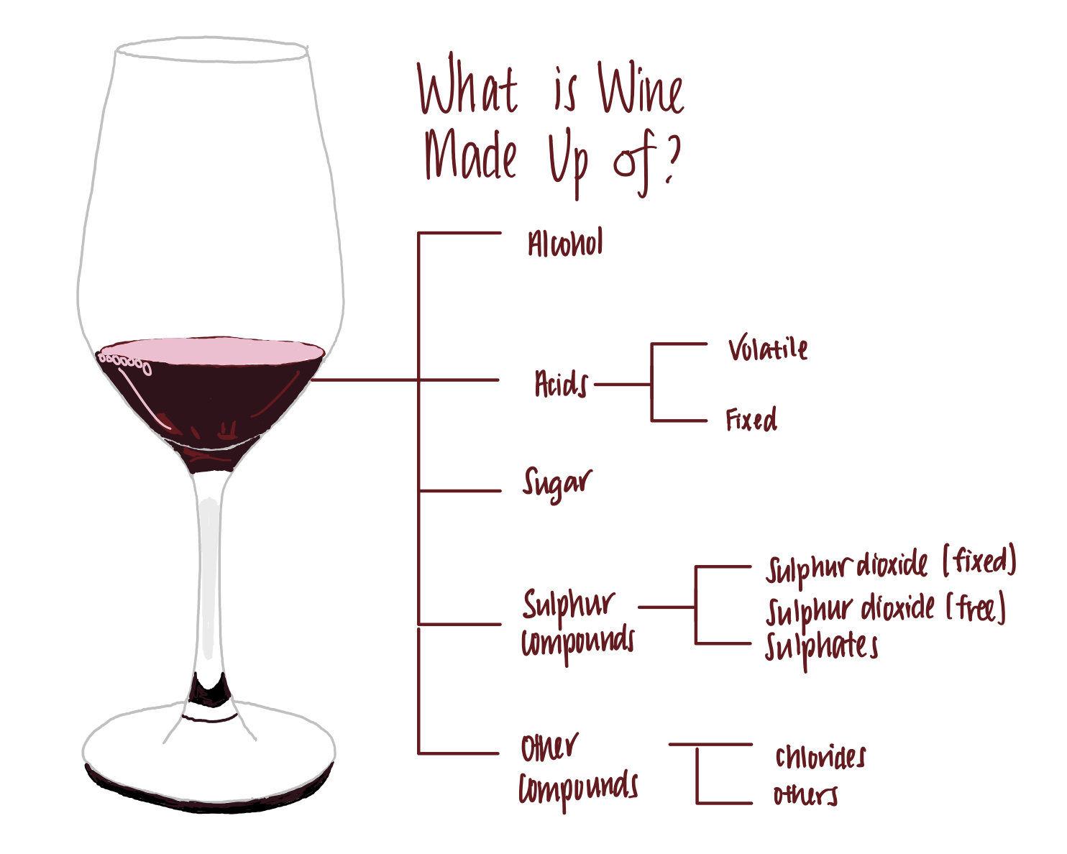
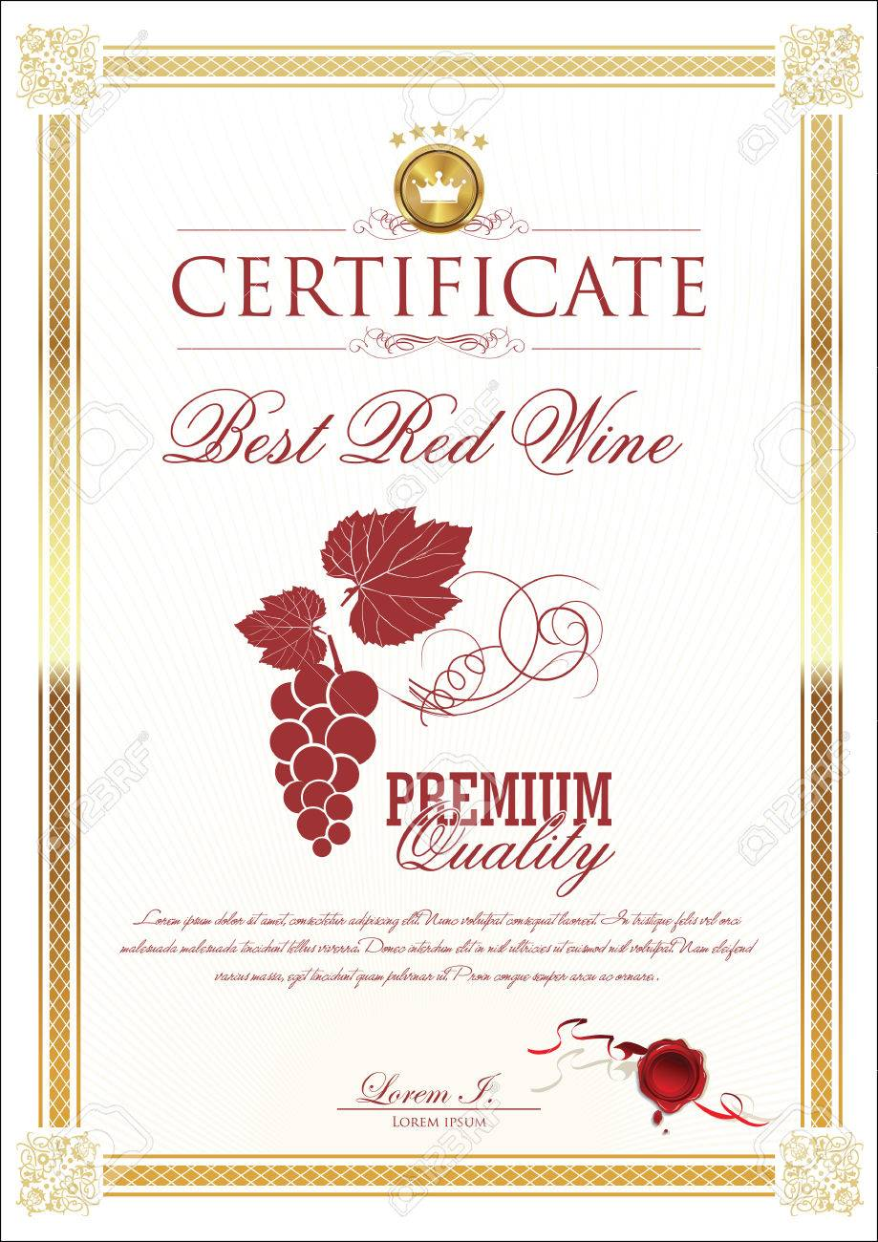
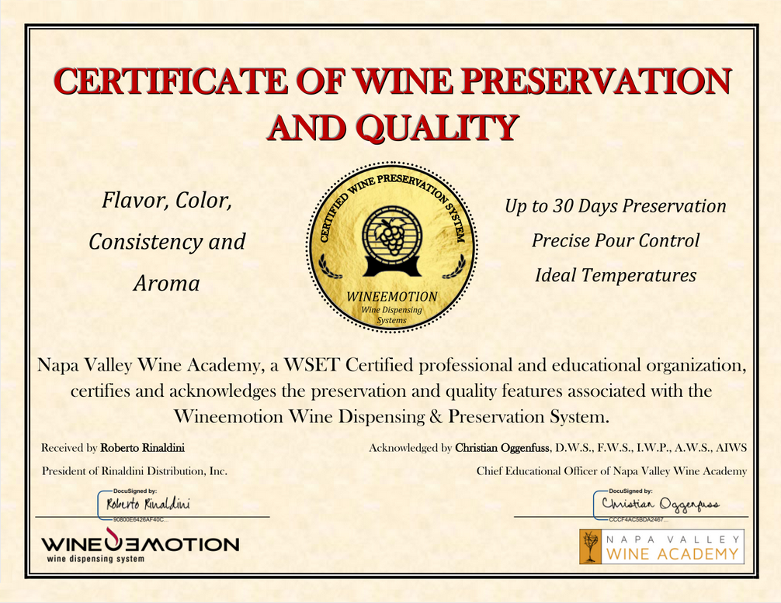
Business Understanding
An important factor in wine certification and quality assessment is physicochemical tests, which are laboratory-based and consider factors like acidity, pH level, sugar, and other chemical properties.
Venkat

Slide 10
HMW Statement
How Might We
Make the best possible wine from the current harvest
Intended action
For
winemakers
Primary User
They are able to consistently deliver good quality wines to the consumers and becoming a key market player in the wine industry
So that
Desired effect
Venkat

Slide 11
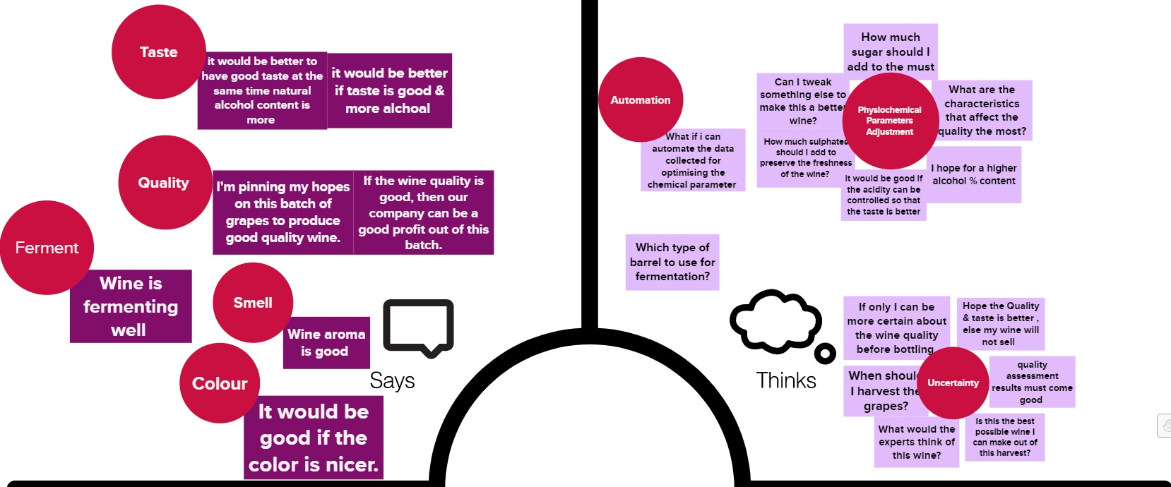

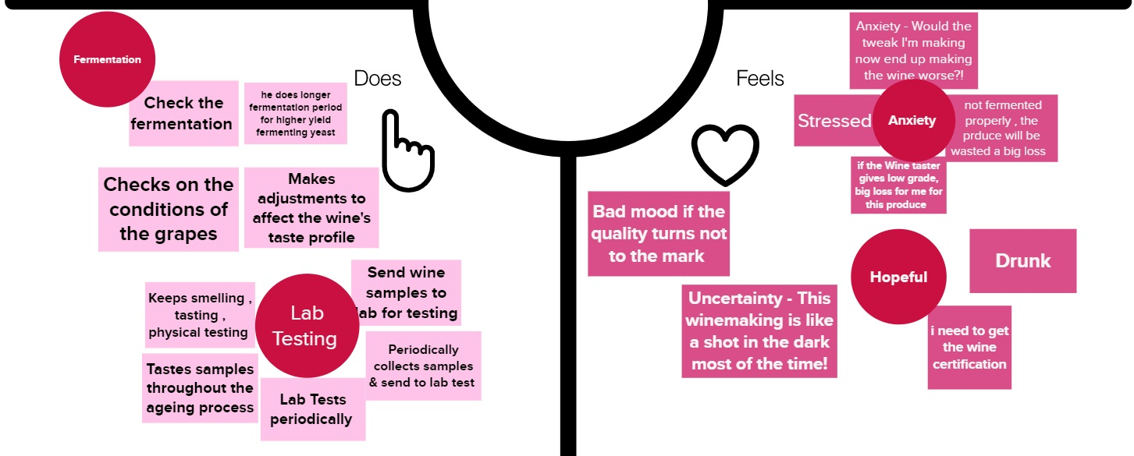
Empathy Map
Venkat

Slide 12
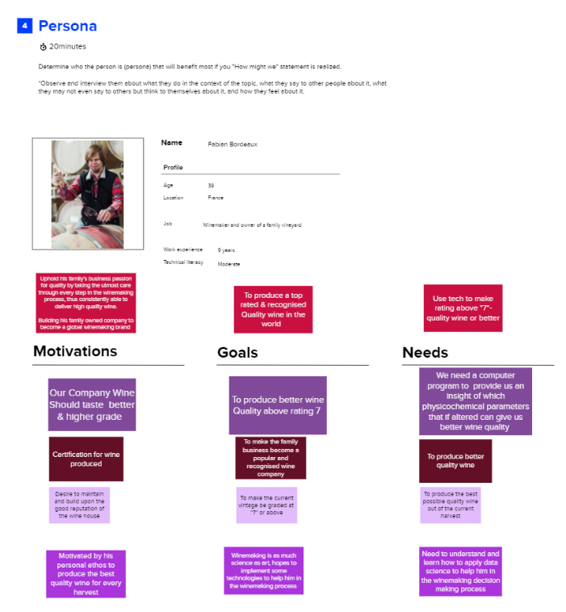
Persona
Venkat

Slide 13
Persona
Fabien Bordeaux
Age :39
Location :France
Job :Winemaker & Owner of a family vineyard
Work Experience :9 Years
Technical Literacy :Moderate
MOTIVATIONS
GOALS
NEEDS
Uphold his family's business passion for quality by taking the utmost care through every step in the winemaking process, thus consistently able to deliver high quality wine. Building his family owned company to become a global winemaking brand
To produce a top rated & recognised Quality wine in the world
Use technology to make rating above "7"-quality wine or better
Venkat

Slide 14
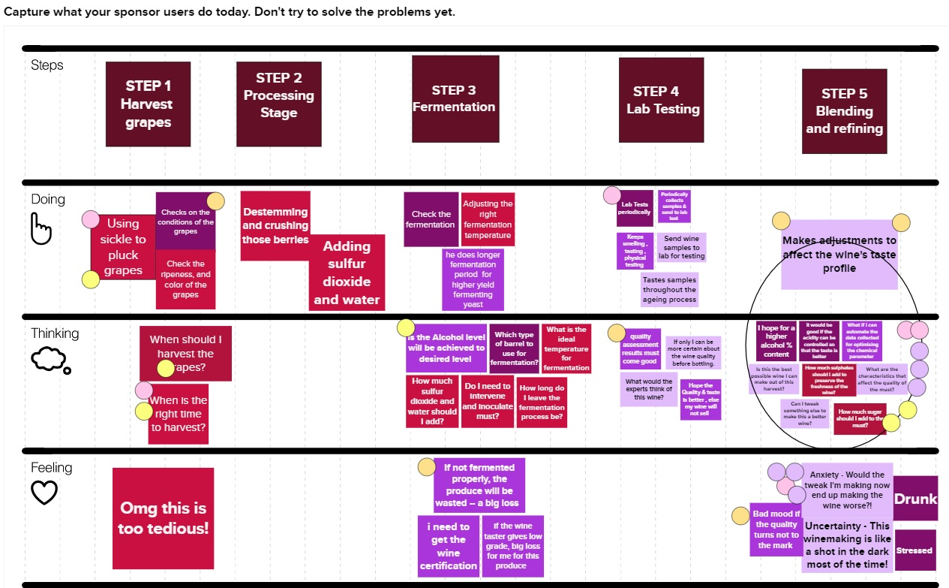
As-is Scenario Map
Venkat

Slide 15

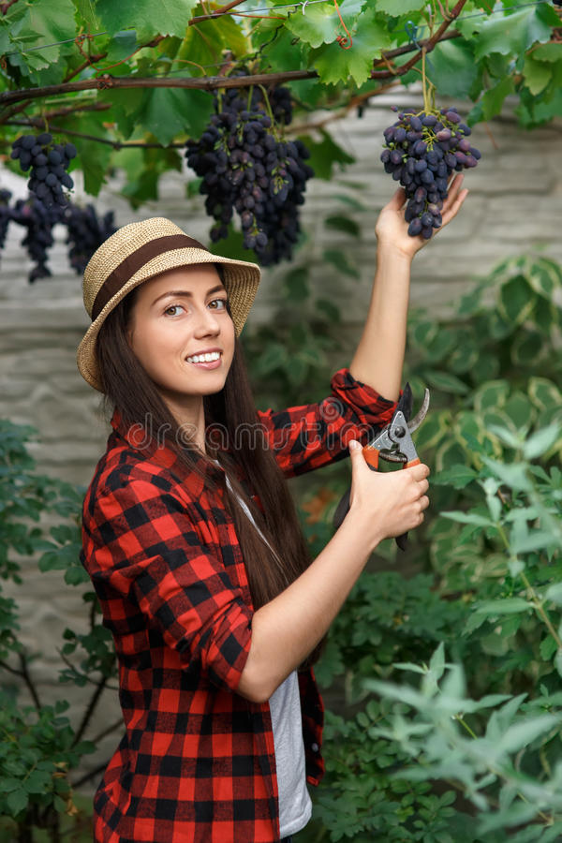
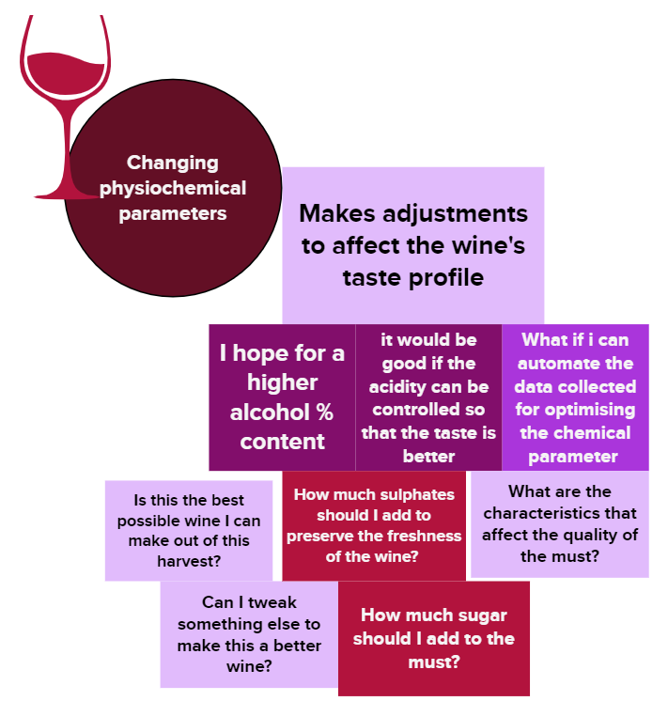
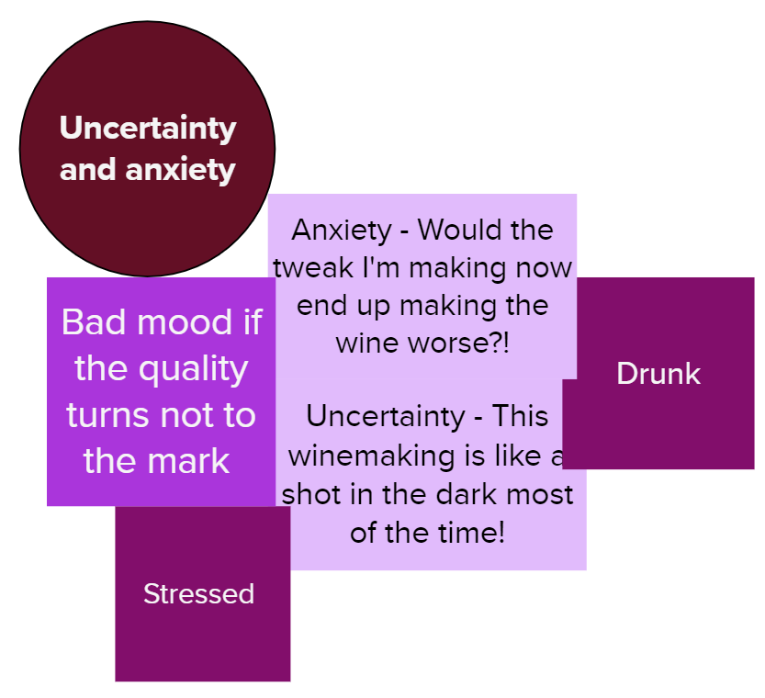
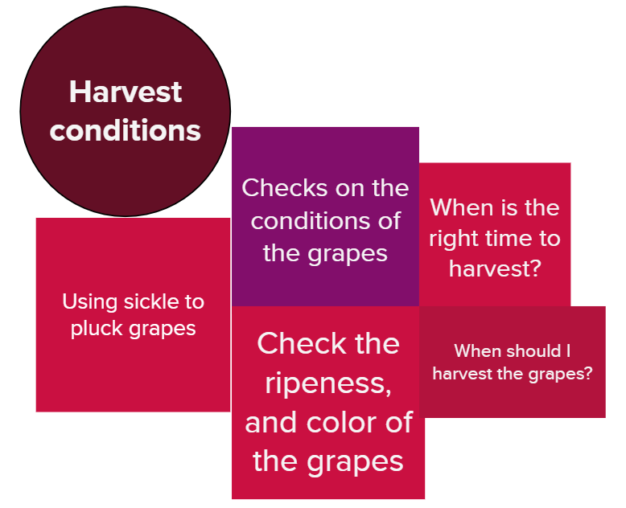
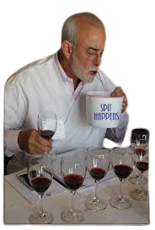
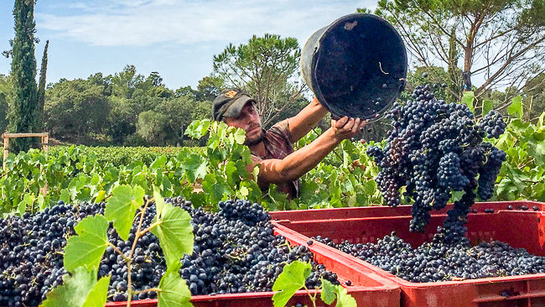
Pain Points
Venkat

Slide 16
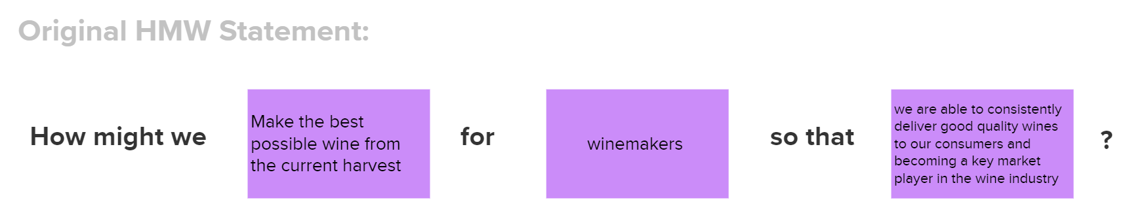
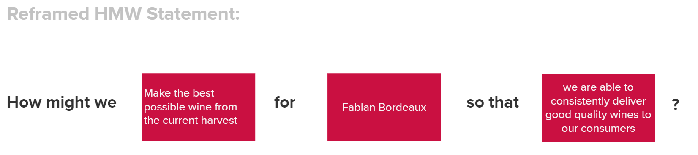

Reframed HMW Statement
Venkat

Slide 17
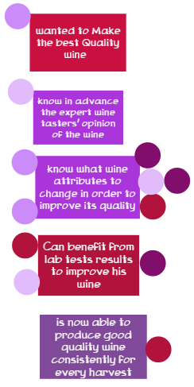
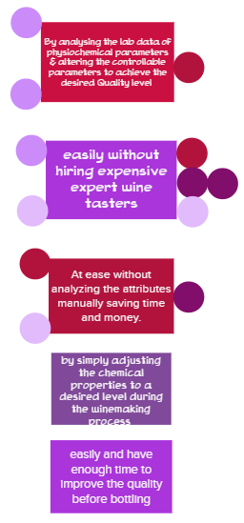

Hill
WHO | WHAT | WOW
Venkat

Slide 18


Hill Statement
Fabian, a winemaker with 9 years of experience in the art of winemaking under his belt, knows what wine attributes to change in order to improve its quality easily without hiring expensive expert wine tasters.
Venkat

Slide 19
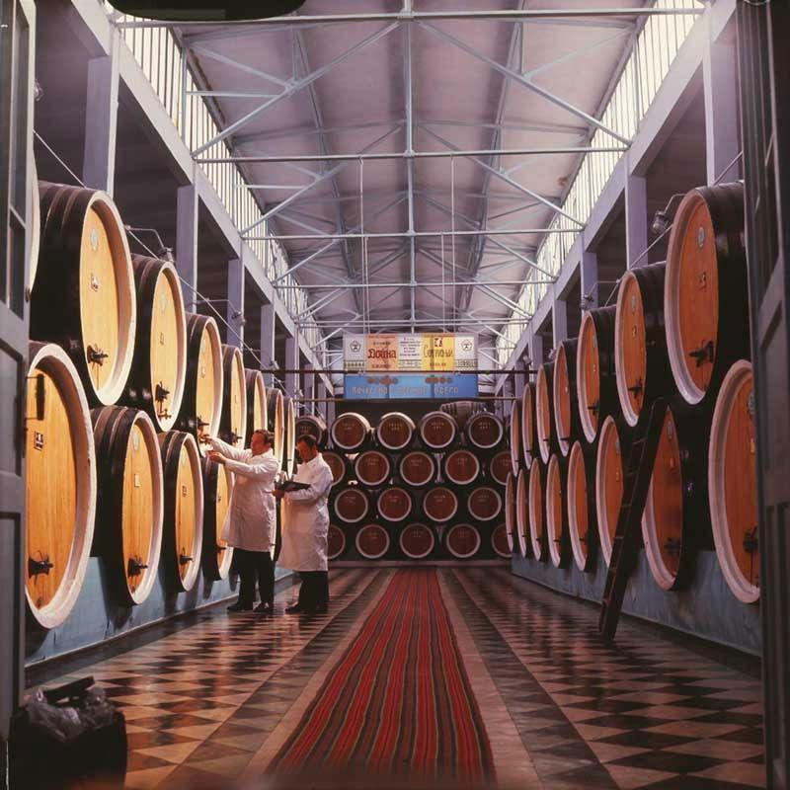
Data Science Methodology 5 stages in Data Science
Planning Analytics
Descriptive Analytics
Diagnostic Analytics
Predictive Analytics
Prescriptive Analytics
John

Slide 20
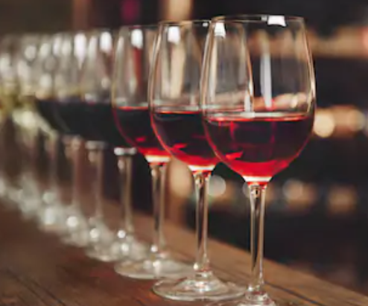
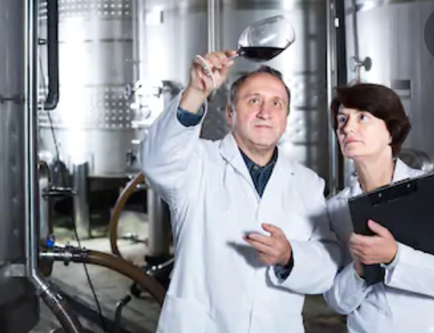
Data Exploration & Preparation
Data Understanding
The red wine dataset is downloaded from UCI repository (https://archive.ics.uci.edu/ml/datasets/wine+quality)
The dataset contains wine samples from the north of Portugal based on physicochemical tests
There are a total of 12 variables (columns) and 1,599 observations (rows)
This data allows us to create different models to determine independent variables help predict our dependent variable (quality)
Understanding how each variable will impact the wine quality will provide insights to producers, distributors, and businesses in the red wine industry to better assess their production, distribution and pricing strategy
John

Slide 21
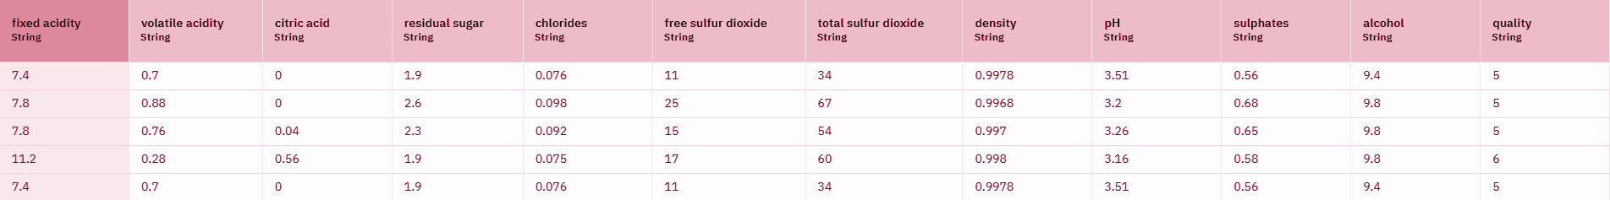
Data Exploration & Preparation
Statistical mean for each physicochemical attributes in both wine types. The attributes include, FA: Fixed Acidity in g (tartaric acid) dm⁻³, VA: Volatile Acidity in g (acetic acid) dm⁻³, CA: Citric Acid in g dm⁻³, RS: Residual Sugar in g dm⁻³, C: Chlorides in g (sodium chloride) dm⁻³, FSD: Free Sulfur Dioxide in mg dm⁻³, TSD: Total Sulfur Dioxide in mg dm⁻³, D: Density in g cm⁻³, pH, S: Sulphates in g (potassium sulphate) dm⁻³, and A: Alcohol in volume percentage
John

Slide 22
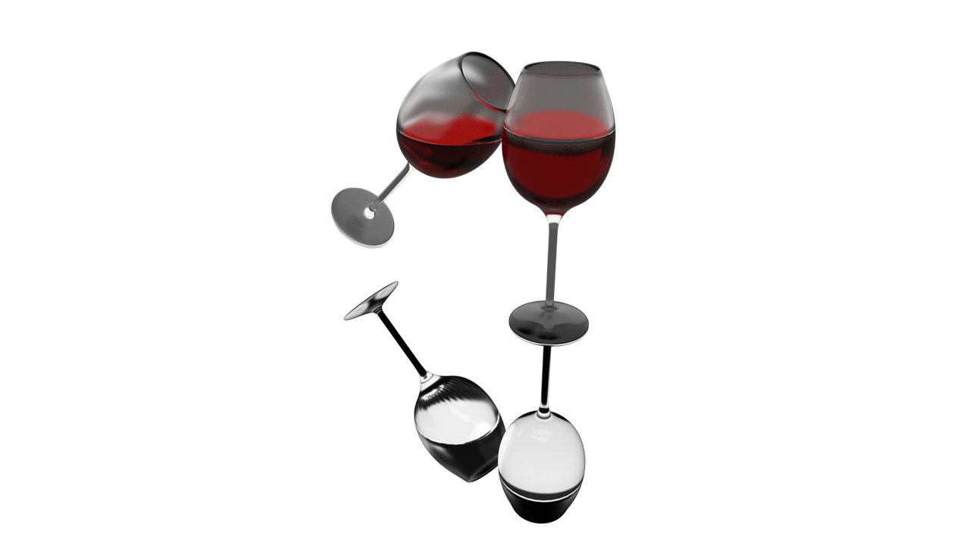
Data Exploration & Preparation
Attributes
Fixed acidity
Titratable acidity, sometimes referred to as fixed acidity, is a measurement of the total concentration of titratable acids and free hydrogen ions present in your wine. A litmus paper can be used to identify whether a given solution is acidic or basic. The most common titratable acids are tartaric, malic, citric and carbonic acid. These acids, along with many more in smaller quantities, either occur naturally in the grapes or are created through the fermentation process
Volatile acidity
Volatile acidity is mostly caused by bacteria in the wine creating acetic acid — the acid that gives vinegar its characteristic flavor and aroma — and its byproduct, ethyl acetate. Volatile acidity could be an indicator of spoilage, or errors in the manufacturing processes — caused by things like damaged grapes, wine exposed to air, and so on. This causes acetic acid bacteria to enter and thrive, and give rise to unpleasant tastes and smells. Wine experts can often tell this just by smelling it!
Citric acid
Citric acid is generally found in very small quantities in wine grapes. It acts as a preservative and is added to wines to increase acidity, complement a specific flavor or prevent ferric hazes. It can be added to finished wines to increase acidity and give a “fresh” flavor. Excess addition, however, can ruin the taste.
Residual Sugars
Residual Sugar refers to any natural grape sugars that are leftover after fermentation ceases. The juice of wine grapes starts out intensely sweet, and fermentation uses up that sugar as the yeasts feast upon it. During winemaking, yeast typically converts all the sugar into alcohol making a dry wine. However, sometimes not all the sugar is fermented by the yeast, leaving some sweetness leftover. To make a wine that tastes good, the key is to have a perfect balance between the sweetness and the sourness in the drink.
John

Slide 23
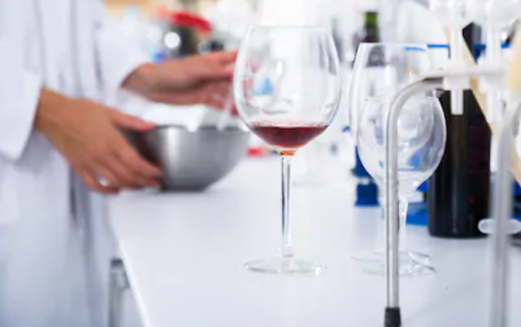
Data Exploration & Preparation
Attributes
Chloride
The amount of chlorides present in a wine is usually an indicator of its “saltiness.” This is usually influenced by the territory where the wine grapes grew, cultivation methods, and also the grape type. Too much saltiness is considered undesirable. The right proportion can make the wine more savory.
Sulfur Dioxide
Sulfur dioxide exists in wine in free and bound forms, and the combinations are referred to as total SO2. It’s the most common preservative used, usually added by winemakers to protect the wine from negative effects of exposure to air and oxygen. Wines with added sulphur dioxide contents usually have “Contains Sulphites” on their labels. It acts as a sanitizing agent — adding it usually kills unwanted bacteria or yeast that might enter the wine and spoil its taste and aroma. It was first used in winemaking by the Romans, when they discovered that burning sulfur candles inside empty wine vessels keeps them fresh and free from vinegar smell.
Density
Also known as specific gravity, it can be used to measure the alcohol concentration in wines. During fermentation, the sugar in the juice is converted into ethanol with carbon dioxide as a waste gas. Monitoring the density during the process allows for optimal control of this conversion step for highest quality wines. Sweeter wines generally have higher densities.
John

Slide 24
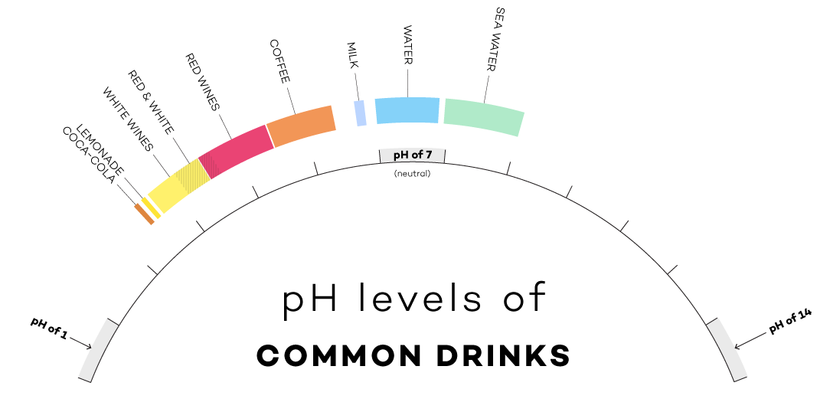
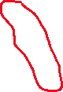
Data Exploration & Preparation
Attributes
pH
pH stands for power of hydrogen, which is a measurement of the hydrogen ion concentration in the solution. Generally, solutions with a pH value less than 7 are considered acidic, with some of the strongest acids being close to 0. Solutions above 7 are considered alkaline or basic. The pH value of water is 7, as it is neither an acid nor a base. For the Wine the best PH level is around 3.5
Sulphates
Sulphates are salts of sulfuric acid. They aren’t involved in wine production, but some beer makers use calcium sulfate — also known as brewers’ gypsum — to correct mineral deficiencies in water during the brewing process. It also adds a bit of a “sharp” taste.
John

Slide 25
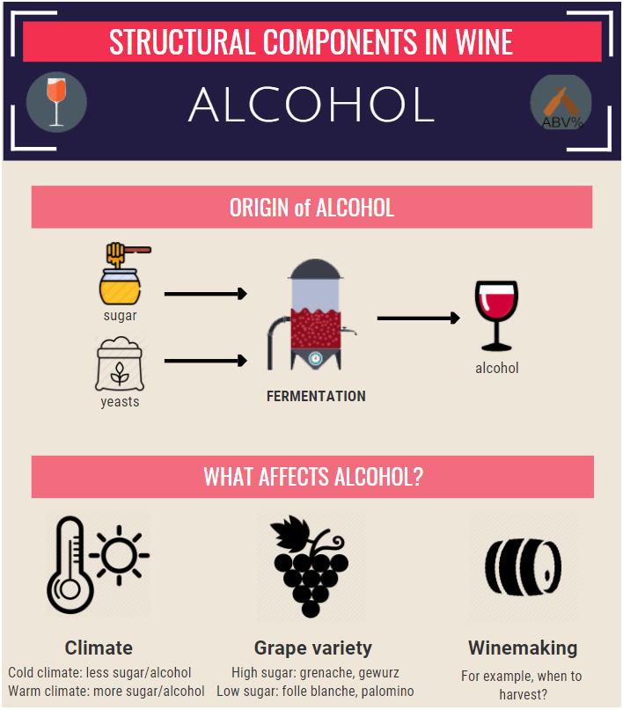
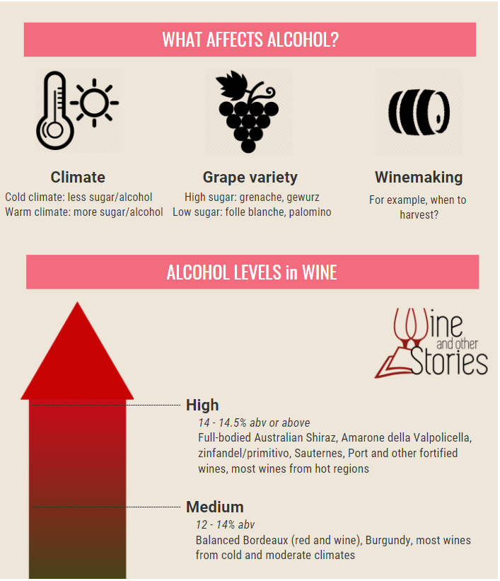
Alcohol
The amount of alcohol in the wine
John

Slide 26
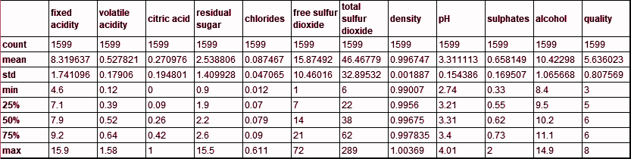
Data Representation & Transformation
Statistical Analysis
Descriptive statistics quantitatively summarize a data set
For an overall sense of data being analysed, we look at mean, standard deviation, median, etc
Obtain information needed to interpret other statistical tests
John

Slide 27
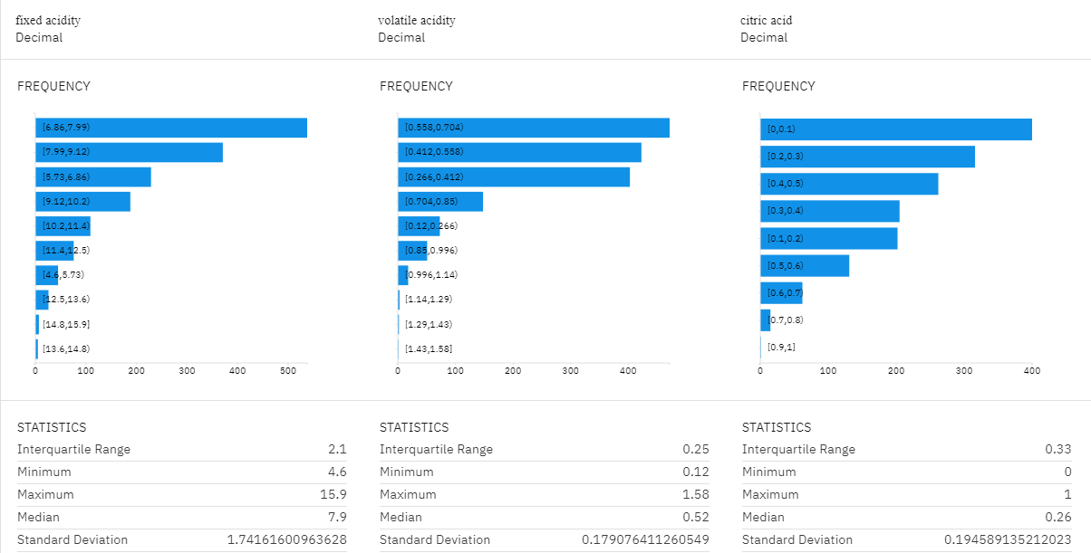
Data Representation & Transformation
Transformation using profile feature in Watson Studio
Use the profile feature for transformation and identify which features are irrelevant
All 11 features are considered relevant variables in predicting the wine quality
John

Slide 28
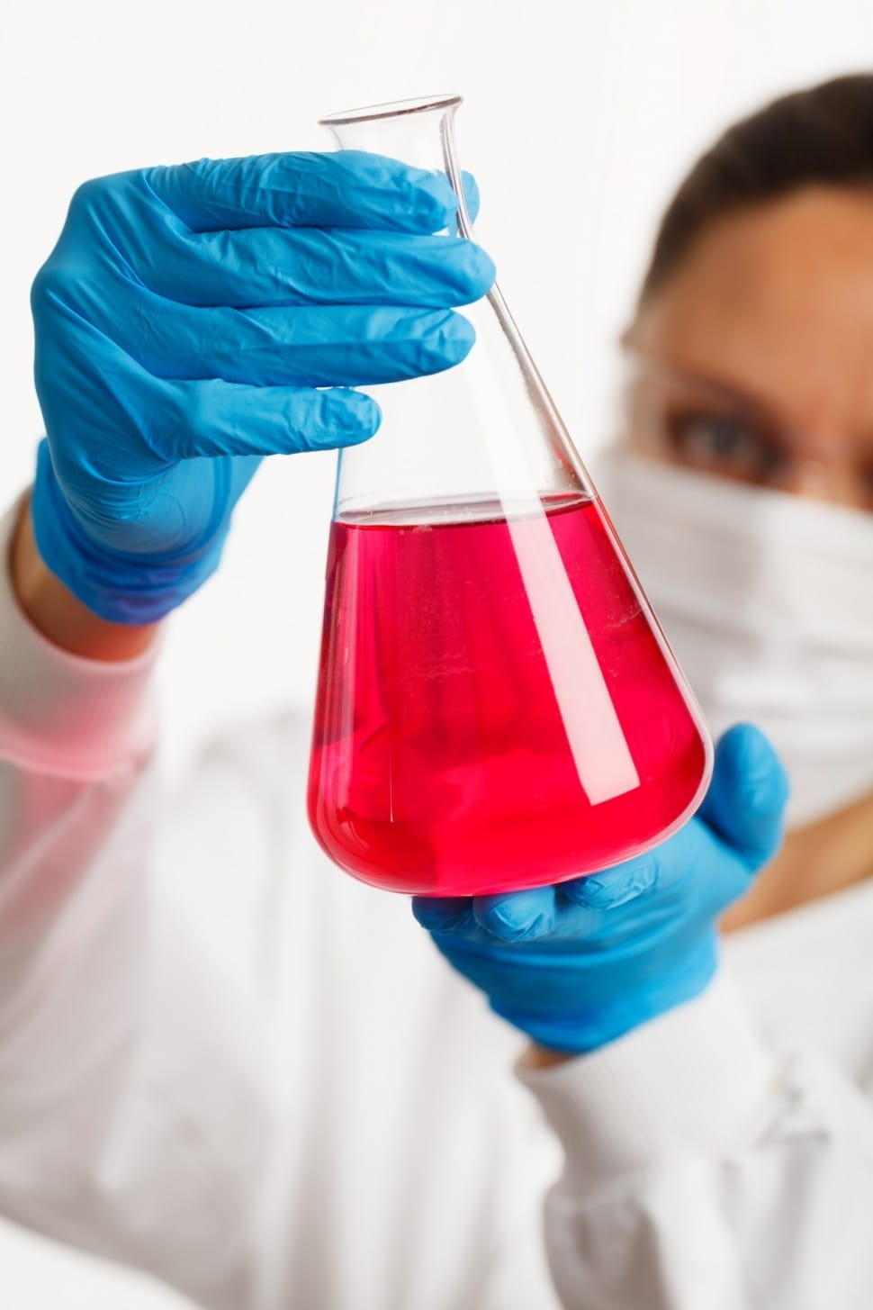
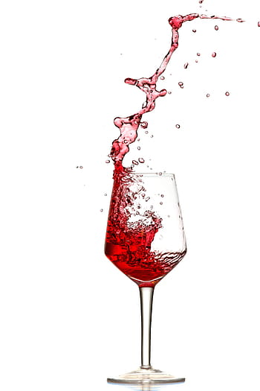
Data Science Methodology 5 stages in Data Science
Planning Analytics
Descriptive Analytics
Diagnostic Analytics
Predictive Analytics
Prescriptive Analytics
John

Slide 29
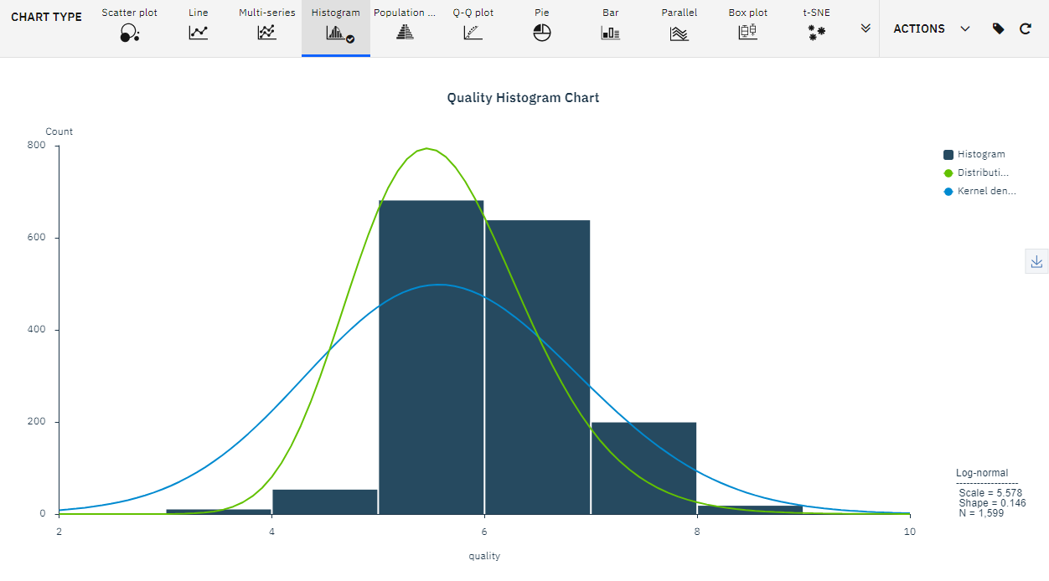
Data Visualisation and Presentation
Exploring Histogram of “quality”
John

Slide 30
Data Visualisation and Presentation
Histogram Quantitative Table
Quality | Count
7 - 10 | 217
5 - 6 | 1319
0 - 4 | 63
Exploring Histogram of “quality”
For our wine quality analysis, we are assuming a rating of 7 and above is considered as “good”, between 5 and 6 is considered as “average” and below 4 is considered as “insipid”
To view the distribution of the quality variable, we apply Histogram visualisation chart in the data refinery. This is to ensure that we have sufficient “good quality” dataset.
As you can see, the wine quality of our dataset follows a normal “bell-curve” distribution, with most wines (82.5%) fall under “average quality”, 13.6% falls under “good quality” and the remaining considered as “insipid” quality
John

Slide 31
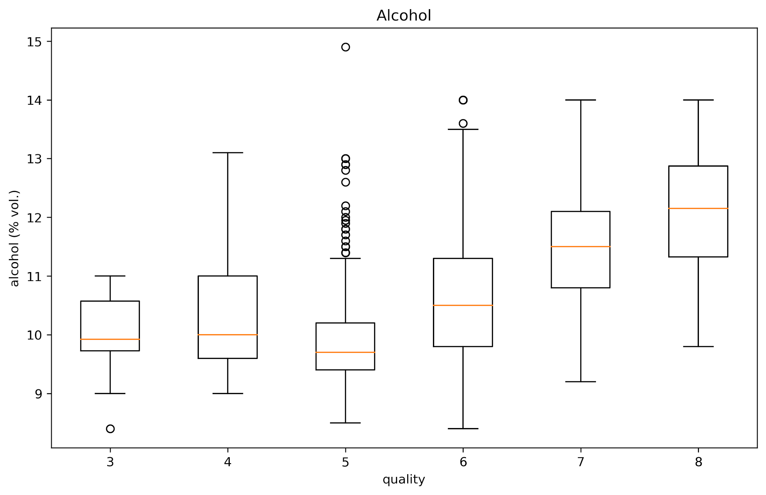
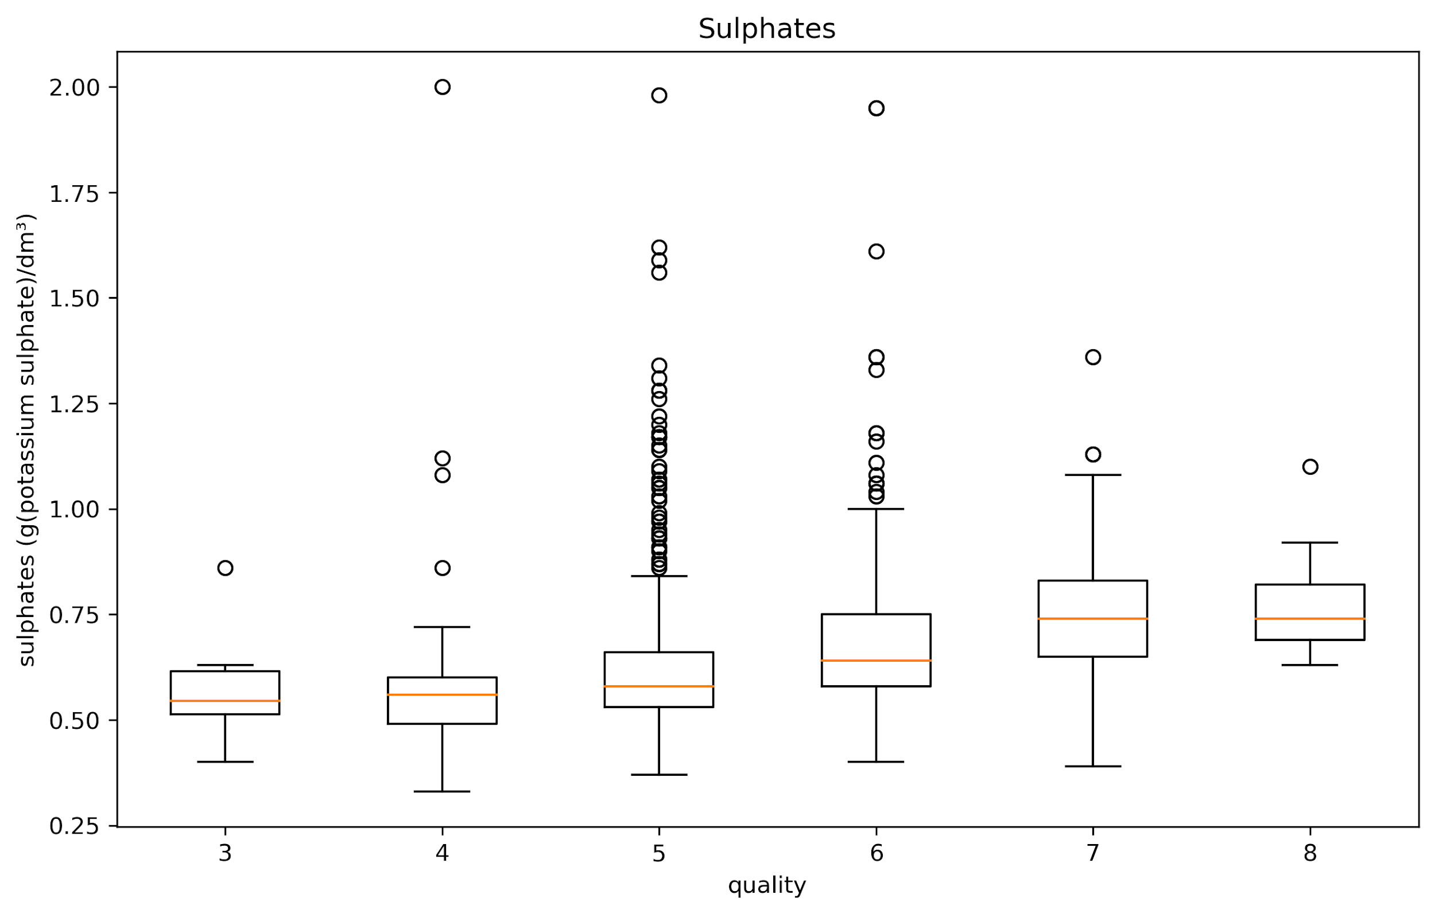
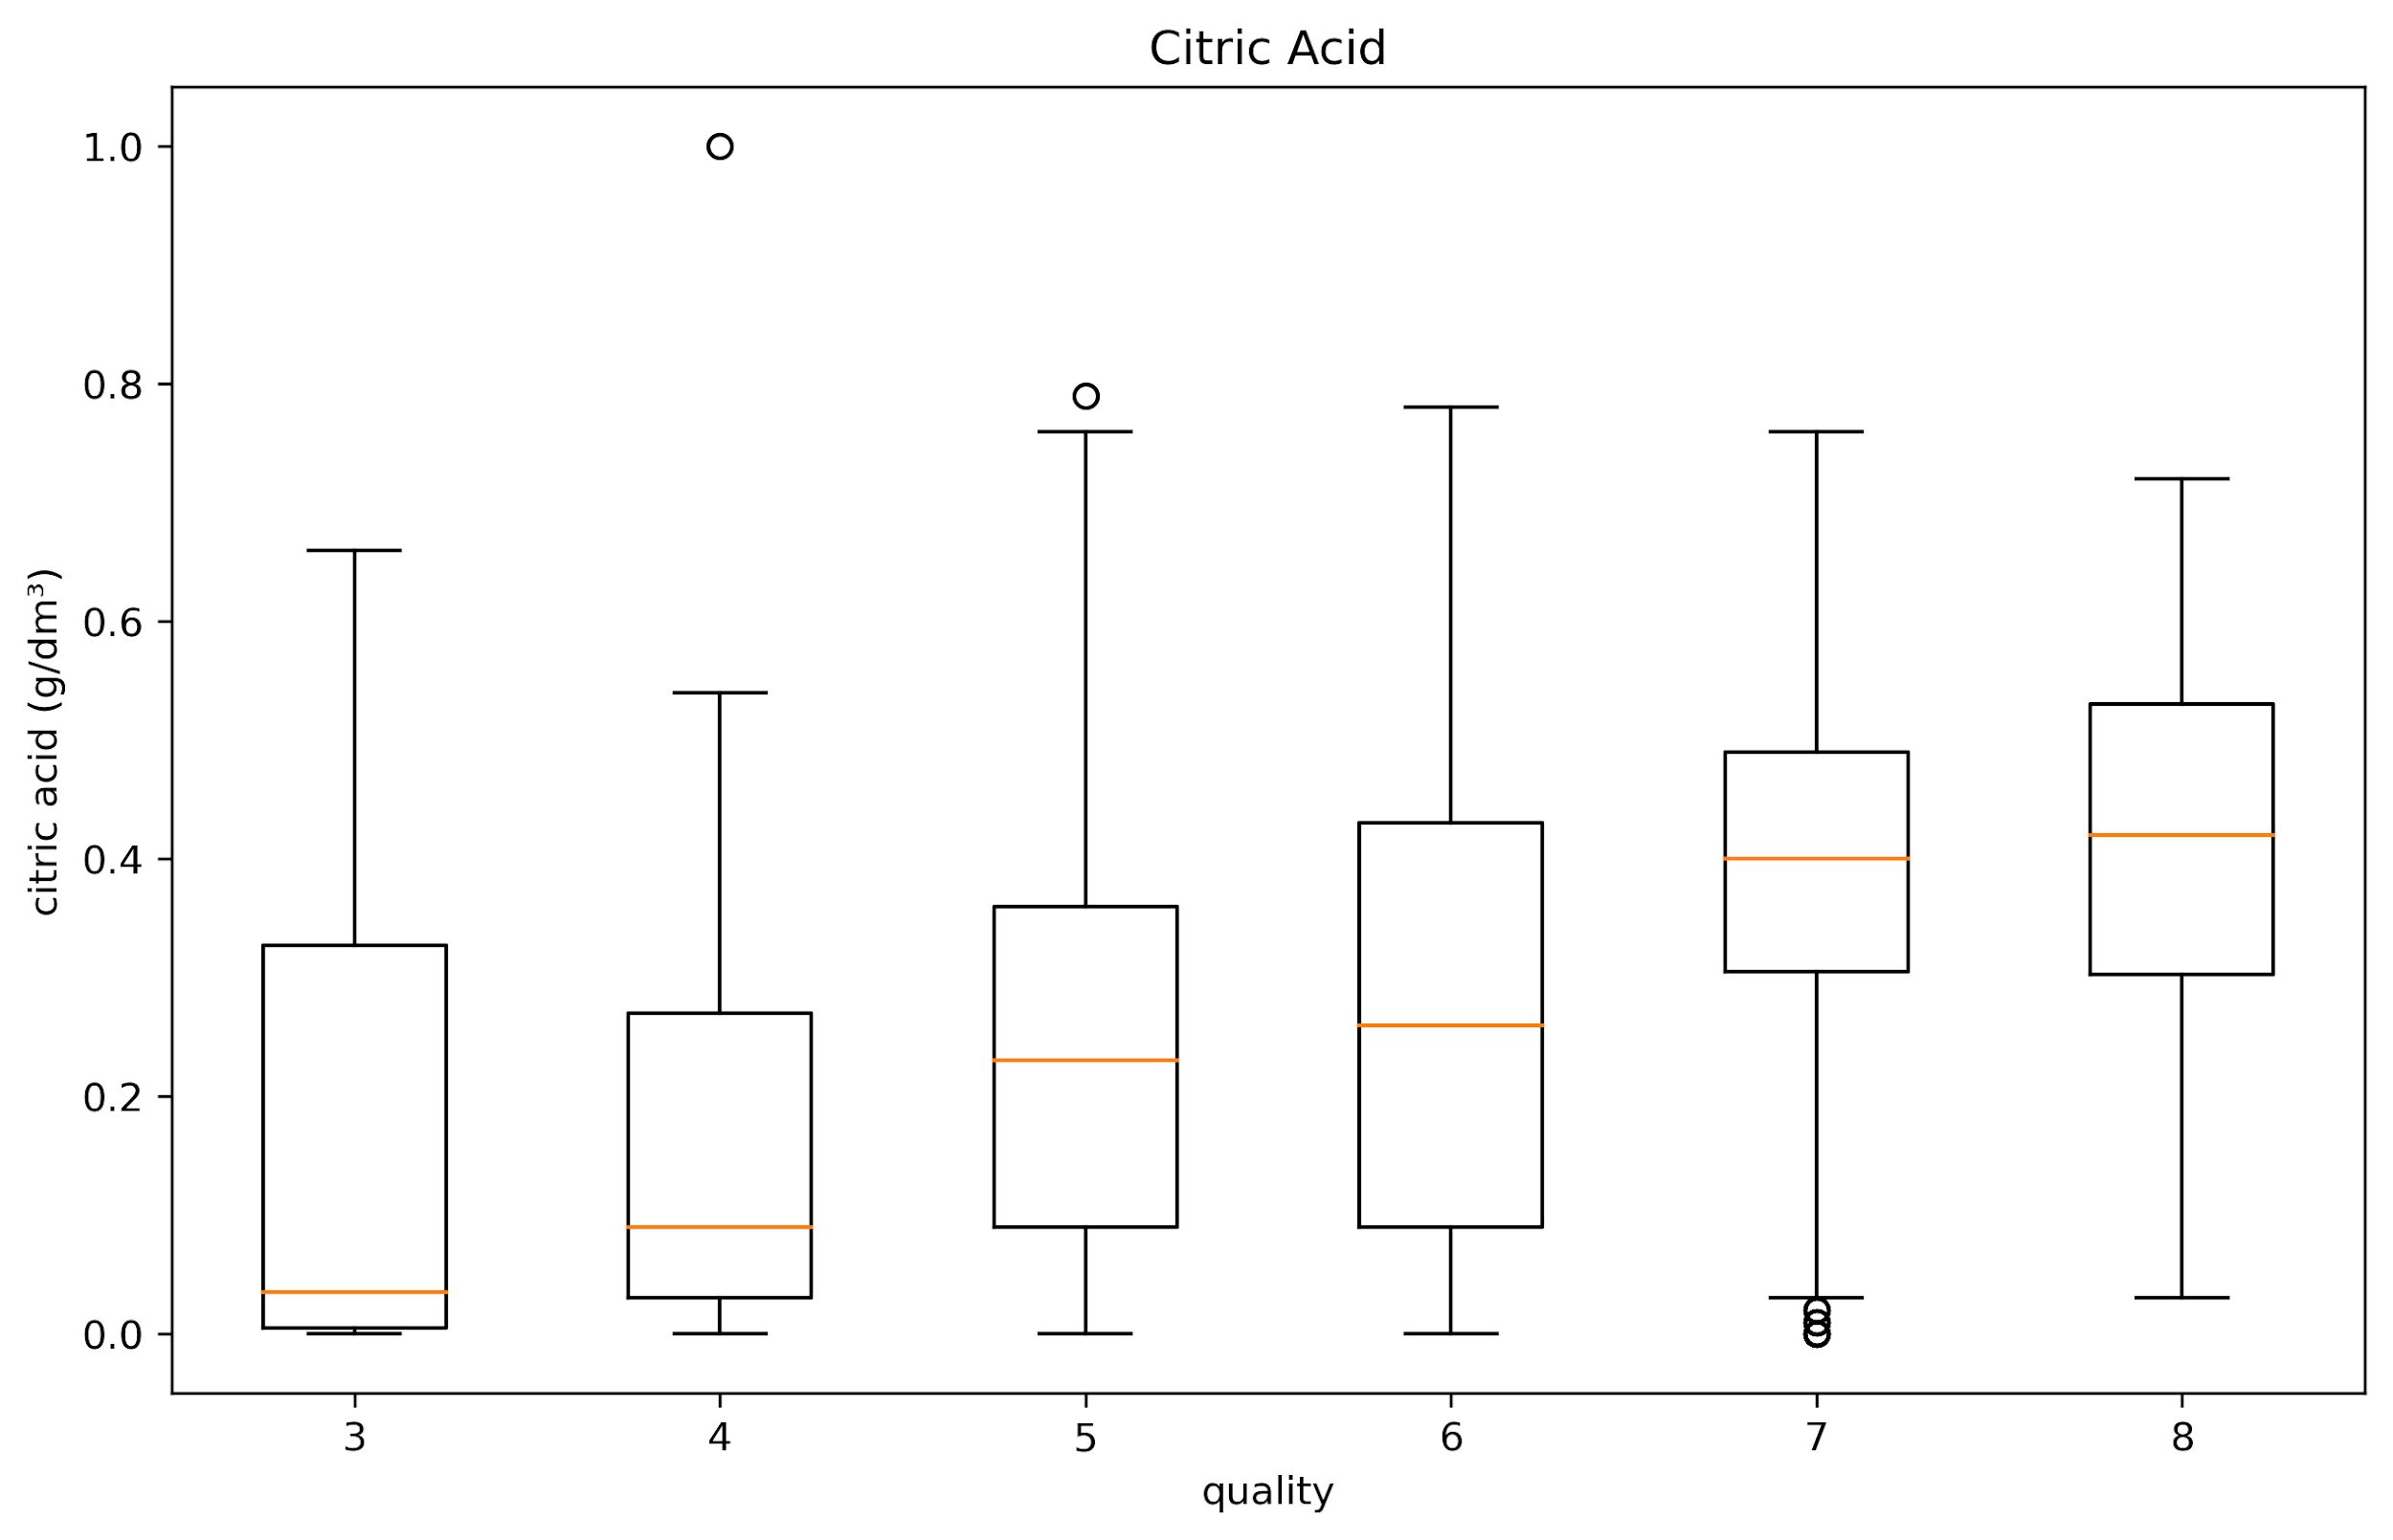
Data Visualisation and Presentation
Box Plot
Next, we will examine the interaction between our numeric variables and our dependent variable, quality rating in detailed.
Box plots show a summary of the main values in a distribution: the lower and upper limits, first and third quantiles, the median and outliers
John

Slide 32
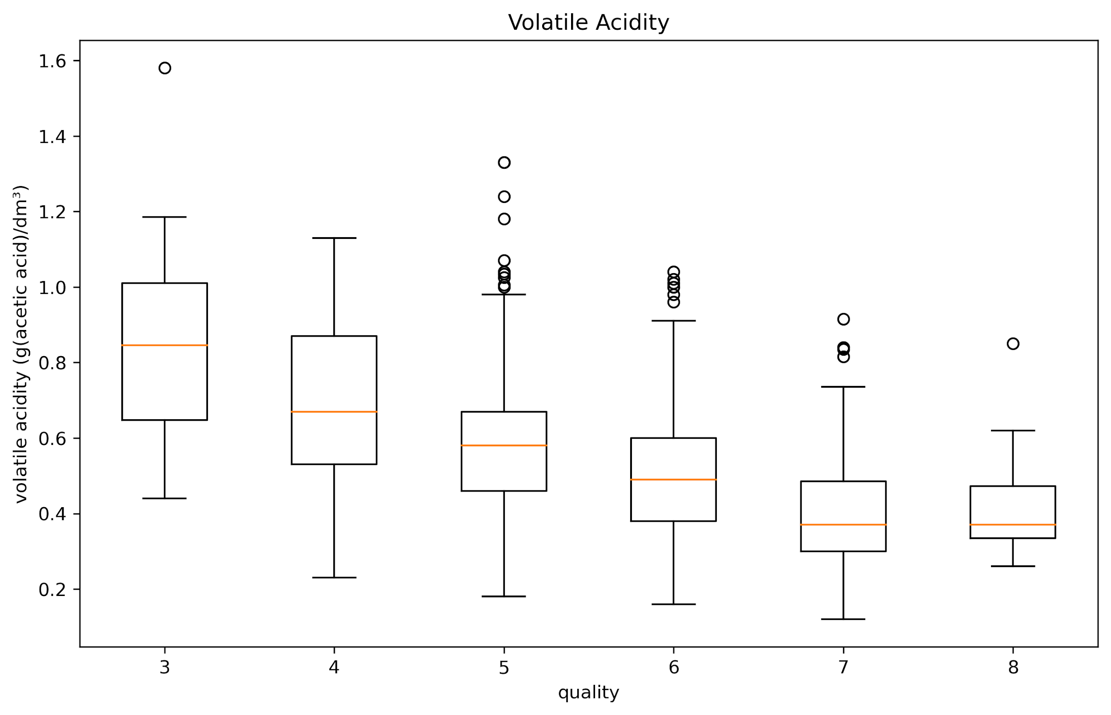
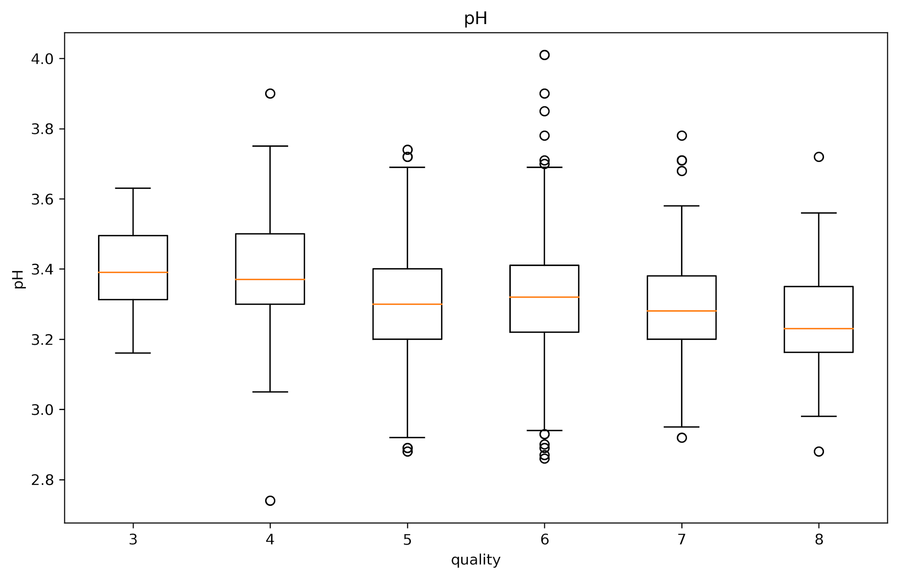
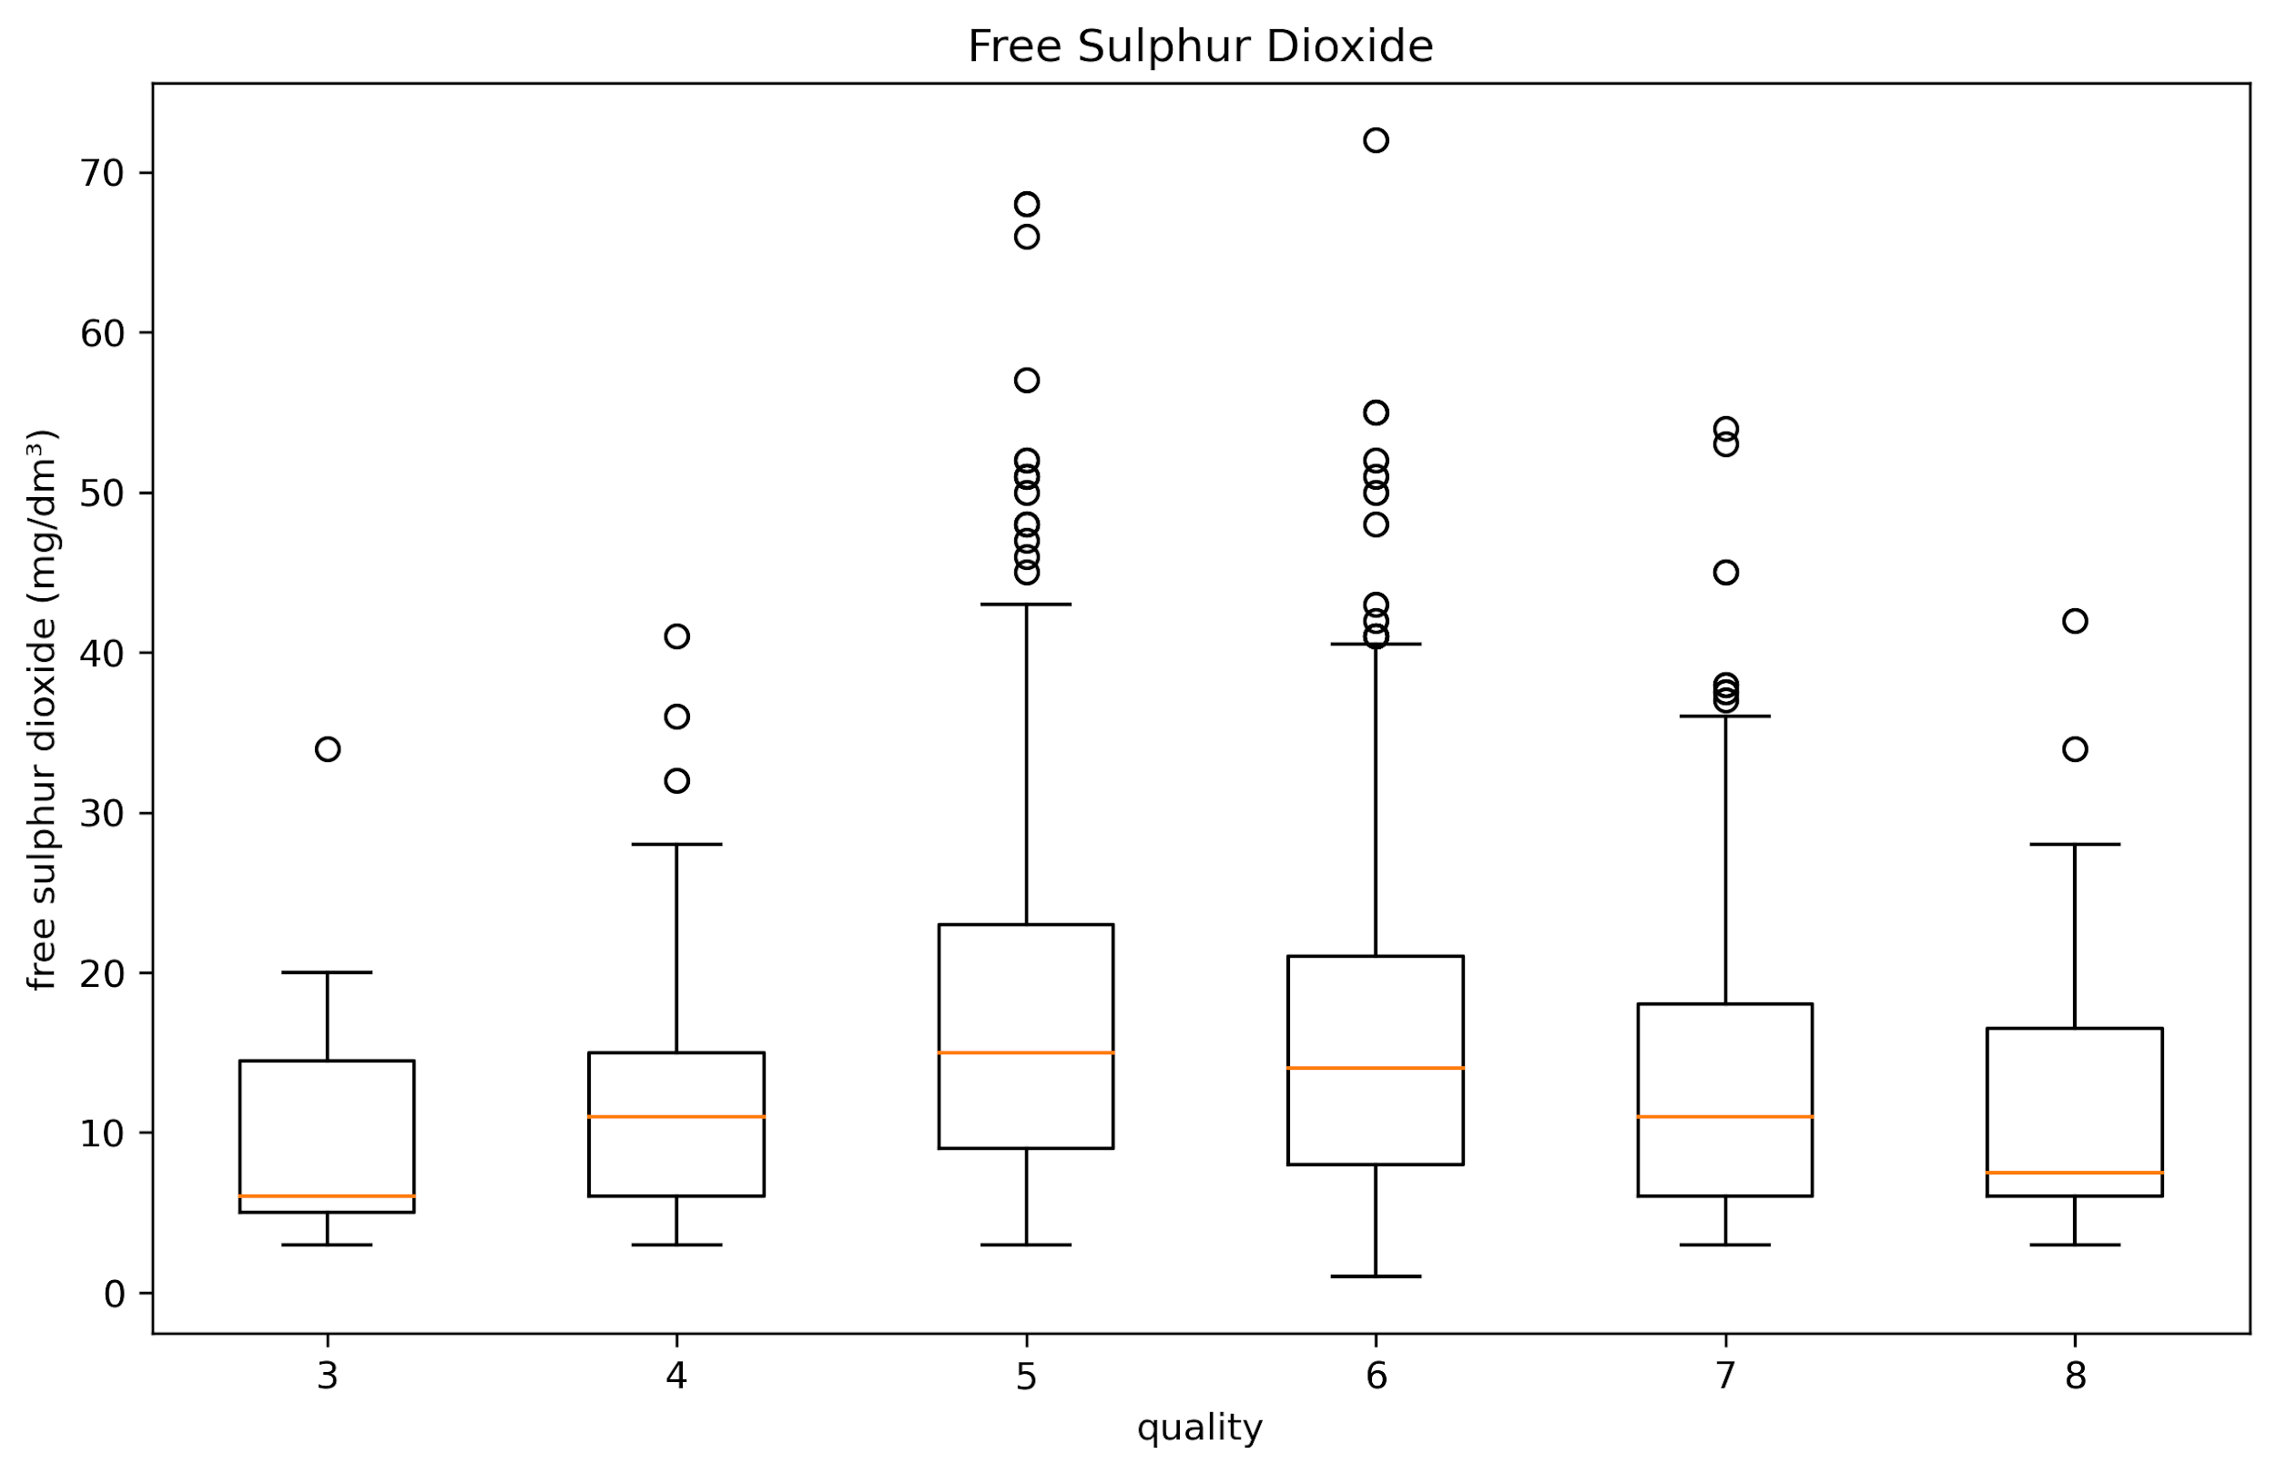

Data Visualisation and Presentation
John

Slide 33




John

Slide 34

Data Visualisation and Presentation
Observations:
Trend observed
As the percentage of alcohol goes up, the wine quality increases, likewise the same pattern is observed for sulphates and citric acid
Wine with a quality rating of 8 has an alcohol range from 9.8 to 14, and a median of 12.2
Wine with a quality rating of 8 has a sulphate range from 0.63 to 1.02, and a median of 0.74
Wine with a quality rating of 8 has a citric acid range from 0.03 to 0.72, and a median of 0.42
We can conclude that generally, wine enthusiast prefers wine with higher alcohol percentage, and higher amount of sulphates preserve the freshness and protect wine from oxidation, and unwanted bacteria and yeasts better, thereby giving a “sharp” taste, and higher amount citric acid gives off a freshness taste.
John

Slide 35
Data Visualisation and Presentation
Observations:
Trend observed
As the amount of volatile acidity reduces, the quality of wine goes up.
Wine quality rating of 8 has a volatile acidity range of 0.26 to 0.73, and a median of 0.37.
A higher quality wine is associated with lower volatile acidity levels. It makes sense, as volatile acidity is an indicator of spoilage and could give rise to unpleasant aromas — consistent with our domain knowledge.
John

Slide 36

Data Visualisation and Presentation
Correlation Heatmap
Correlation depicts a relationship or connection between 2 factors. A coefficient of 1 shows a perfectly positive correlation, whilst a -1 shows a perfectly negative correlation, and a value close to 0 shows no relationship between the 2 factors
From the chart, in ranking of the highest correlation with “quality”, these variables are:
Alcohol : 0.48
Volatile acidity : -0.39
Sulphates : 0.25
Citric acid : 0.23
Total Sulfur dioxide : - 0.19
Density : -0.17
Chlorides : - 0.13
Fixed acidity : 0.12
pH : -0.058
Free Sulfur Dioxide : -0.051
Residual Sugar : 0.014
John

Slide 37
Data Visualisation and Presentation
Conclusion:
Alcohol, sulphates and citric acid seem to have a positive relationship with quality
Volatile acidity has a negative relationship with quality
The remaining chemical properties do not seem to have significant impact on quality
John

Slide 38


Data Science Methodology 5 stages in Data Science
Planning Analytics
Planning Analytics
Descriptive Analytics
Descriptive Analytics
Diagnostic Analytics
Diagnostic Analytics
Predictive Analytics
Predictive Analytics
Prescriptive Analytics
Prescriptive Analytics
Jonelle

Slide 39







Platform Selection
Collaboration
Scalability
Jonelle

Slide 40



Job was created to save the new dataset including the new “Rating” column.
Jonelle

Slide 41


below 4(Bad)
5-6(Average)
above 7(Good)
Jonelle

Slide 42



Data Modelling
Building a wine quality prediction model using IBM Watson Studio’s AutoAI
The objective is to predict the wine quality (scale of 1 to 10) with a set of physicochemical properties and AutoAI recommended MULTICLASS classification as the prediction type for our dataset.
Jonelle

Slide 43



Pipeline Dashboard
Jonelle

Slide 44


XGBoost stands for “Extreme Gradient Boosting”. XGBoost is an optimized distributed gradient boosting library designed to be highly efficient, flexible and portable. It implements Machine Learning algorithms under the Gradient Boosting framework. It provides a parallel tree boosting to solve many data science problems in a fast and accurate way.
Jonelle

Slide 45



Model Evaluation
Jonelle

Slide 46



Feature Importance
Alcohol
Jonelle

Slide 47
Data Science Methodology 5 stages in Data Science
Planning Analytics
Descriptive Analytics
Diagnostic Analytics
Predictive Analytics
Prescriptive Analytics
Jonelle

Slide 48


Model Deployment
Promoting model to deployment space.
Redwine Quality Team4 Deployment
Creating new deployment space.
Jonelle

Slide 49




Promoted asset in deployment space
Online deployment
Created Online deployment
Jonelle

Slide 50





Original Dataset
Training set
Test set
Training, tuning and evaluation
Machine learning Algorithm
Predictive Model
Jonelle

Slide 51



The trained model is evaluated with a testing data set.
The testing data set is a separate portion of the same data set from which the training set is derived.
Jonelle

Slide 52


We have done a test and got the following test results which is close to the accuracy of the model.
Jonelle

Slide 53

XG Boost Vs Regression Model
We have done a test and got the following test results which is close to the accuracy of the model.

Slide 54
Model Management
After deploying assets, assets can be managed and updated to make sure they are performing well and to monitor their accuracy.
Here are some ways we can manage or update the deployment:
Update
Scale
Delete
Eric
Notes:
Update a deployed asset. For example, you can replace a model with a better-performing version without having to create a new deployment.
Scale a deployment to increase availability and throughput by creating replicas of the deployment.
Delete a deployment to remove a deployment and free up resources.

Slide 55

Conclusion
Effect on Quality
From Diagnostic Analytics and Data Visualizations…
Alcohol
Sulphates
Citric Acid
Volatile acidity
From Machine Learning…
Alcohol
Sulphates
Primary and Secondary Most Important Features
Eric

Slide 56
Conclusion
Recommendations
Start with alcohol…
Then adjust sulphates…
And if still necessary, try adjusting citric acid levels.
Subject to “Balance” and Wine Label’s Style
Eric

Slide 57

Data Modelling
1st Run
Feature Importance
Top 6 features in predicting the wine quality
Alcohol
NewFeature_0 - pca(all)
Sulphates
NewFeature_4 - pca(all)
Volatile acidity
NewFeature_5 - pca(all)
Eric

Slide 58

Data Modelling
2nd Run
Feature Importance
Top 6 features in predicting the wine quality
NewFeature_11 - Combination of alcohol and sulphates
NewFeature_6 - Combination of alcohol and citric acid
Sulphates
NewFeature_10 - Combination of alcohol and pH
Sulfur Dioxide
Volatile acidity
Eric

Slide 59
So many questions!
What is PCA?
Why does the same feature appear multiple times in list of important features?
Why do you get different lists of important features when you build a seemingly same model using the same algorithm?
Eric

Slide 60


What is PCA?
Principal Component Analysis
Mathematical method to reduce “dimensionality”.
Eric

Slide 61

Why?
Why does the same feature appear multiple times in list of important features?
Eric

Slide 62
Why?
Why do you get different lists of important features when you build a seemingly same model using the same algorithm?
Main reasons:
AutoAI’s Feature Engineering
Stochastic nature of “Random Forest” algorithm
Eric

Slide 63

Thank You

Slide 65


AutoAI experiment based on Regression
Pipeline Billboard

Slide 66



Slide 67


Creation of Deployment Space
Promoting asset in deployment space

Slide 68


Creating of AutoAI experiment.
AutoAI Experiment summary

Slide 69

Dataset

Slide 70

Data Modelling
Result as shown below, XGB Classifier yields the highest accuracy followed by Decision Tree Classifier
XGBoost is a decision-tree-based ensemble machine learning algorithm that uses a gradient boosting framework
1st Run

Slide 71

Data Modelling
2nd Run

Slide 72

Data Modelling
Model Evaluation
1st Run

Slide 73

Data Modelling
Model Evaluation
2nd Run

Slide 74
XG Boost Vs Regression Model
We have done a test and got the following test results which is close to the accuracy of the model.

